Slide 1
Automotive Warranty Analytics: Data-Driven Insights for Service Optimization
Rehan Ahmed Rikati

Slide 2
Business Problem
Increasing warranty claims and service cost were impacting profitability.
No central system existed to analyze vehicle performance, claim trends and reliability patterns
The goal was to identify high risk models and cost saving opportunities through data driven insights

Slide 3
Objective and Analytical Approach
Objectives:
Analyze Service, warranty and sensor data.
Identify trends in claims rates and service cost
Measure reliability and vehicle aging impact
Approach:
Excel for early exploration of data.
Data cleaning using python. Handled nulls, fixed typos, standardized text.
SQL based Exploratory data analysis (CTE, window function, aggregations).
Power BI for actionable insights.
Data
Python
SQL
Power BI Dashboard
Excel

Slide 4
Dataset Summary
Table | Rows | Column | Description
Vehicles | 10,000 | 5 | Model, Year, Mileage, Region
Service Records | 60,000 | 6 | Service date, Component Cost, Issue type
Warranty Claims | 20,000 | 6 | Claim date, Status, Amount, Component
Sensor Data | 100,000 | 6 | Engine temp, RPM, Fuel Efficiency, Error codes
Synthetic but realistic data created to simulate real world automotive records.

Slide 5
Data Cleaning highlights
Removed duplicates from region and model names.
Fixed missing values using median values.
Converted date to datetime format.
Replaced invalid service cost and negative values to 0.
Replaced NULLs with placeholder like “Unknown”.
Standardized region and model names.

Slide 6
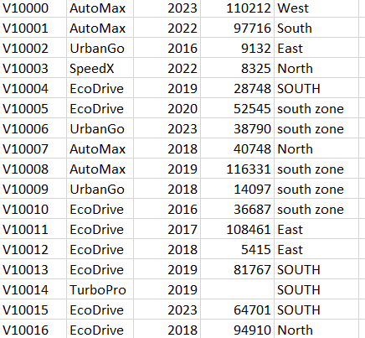
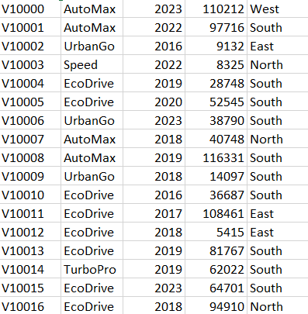




Raw and Cleaned Data Examples

Slide 7
SQL Insights Summary
Vehicle age over 8 years old show a 25% increase in service frequency.
TurboPro and AutoMax models report the highest average service cost.
TurboPro has the highest claim approval rate (87.81%).
Reliability score correlates highly with mileage and service history.
TurboPro has the highest average mileage.

Slide 8
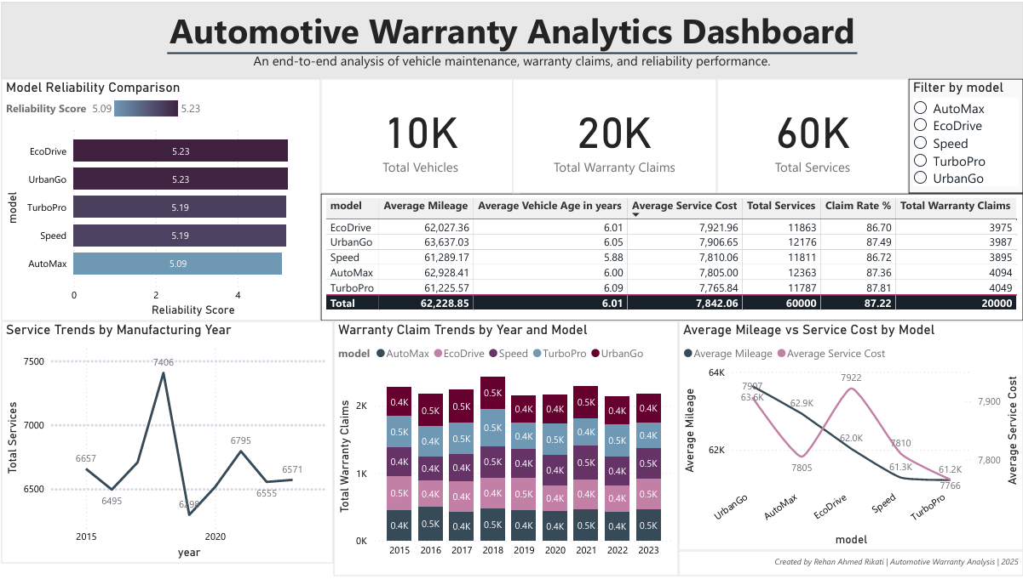
Power BI Dashboard

Slide 9
Recommendations
High Frequency Service model: TurboPro and AutoMax nee deeper quality checks.
Preventative Maintenance: Focus on vehicles with mileage greater than 80k to reduce future claims.
Warranty Optimization: Review approval criteria to cut rejection delay.
Sensor data integration: Use temperature and RPM patterns for early fault detections.

Slide 10
Thank You
Rehan
ronv1736@gmail.com
+919535238447

